Slide 1
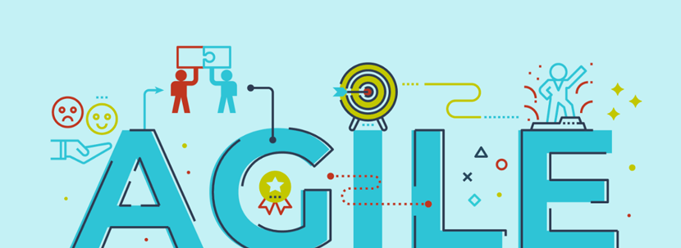
Presentation
By scott Rowe
Southern new Hampshire university

Slide 2
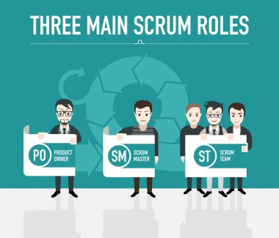
The product - is responsible for conveying the vision of the stakeholders to the team(Nicholson, 2022). scrum master - It is their duty to remove all the hindrances or obstructions in the way of achieving any goal and they enforce scrum ceremonies and processes (Nicholson, 2022). scrum team - is responsible for all the activities that lead them towards their sprint goals, and They must work with the Scrum Master to prioritize the items from the product backlog in the sprint planning (Nicholas, 2022).

Slide 3
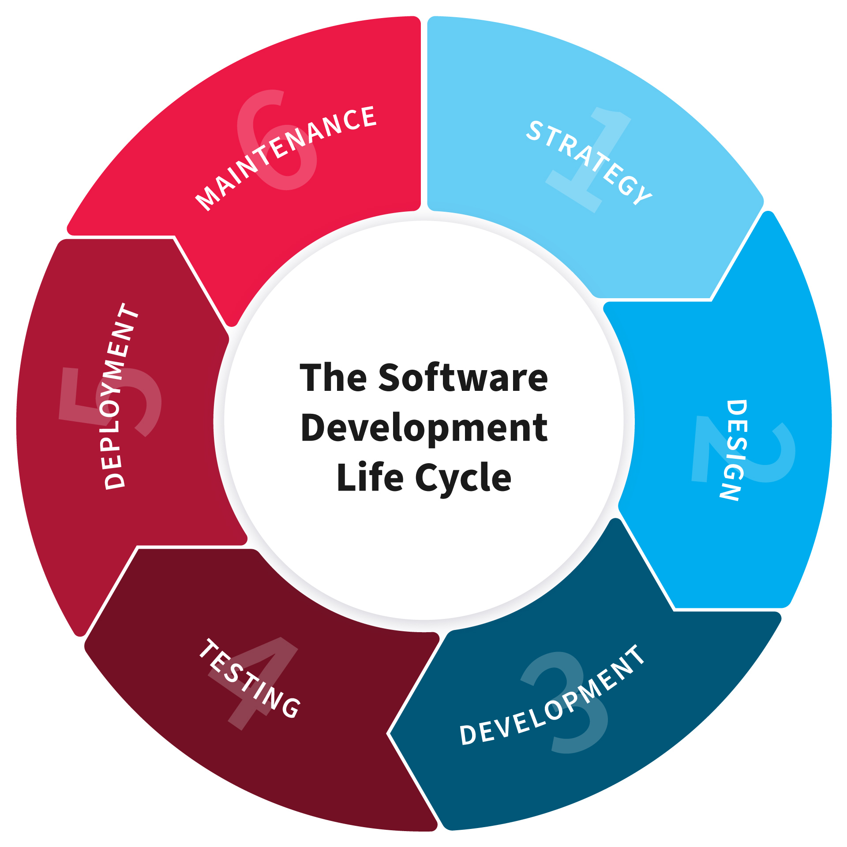
The names of the phases 1.Strategy - first SDLC stage starts from defining system goals and objectives and the problems the future system needs to solve. 2.Design - This stage deals with how the system will work, focusing on software design and how it works with the technical and functional requirements of the system. 3.Development - In this SDLC stage, the software engineering team builds the entire system by writing code using the chosen technologies. 4.Testing - This vital phase tests the software to ensure everything works as expected 5.Deployment - Software deployment includes all processes that ensure a software system or update is available to the users. 6.maintenance - In this phase, the development team processes feedback fixes bugs discovered by users or stakeholders and provides ongoing enhancements(vorobiova, 2021).
Notes:
All six of these phases are explained in the four scrum ceremonies that are Sprint Planning, Daily Scrum, Sprint Review, and Retrospective.

Slide 4
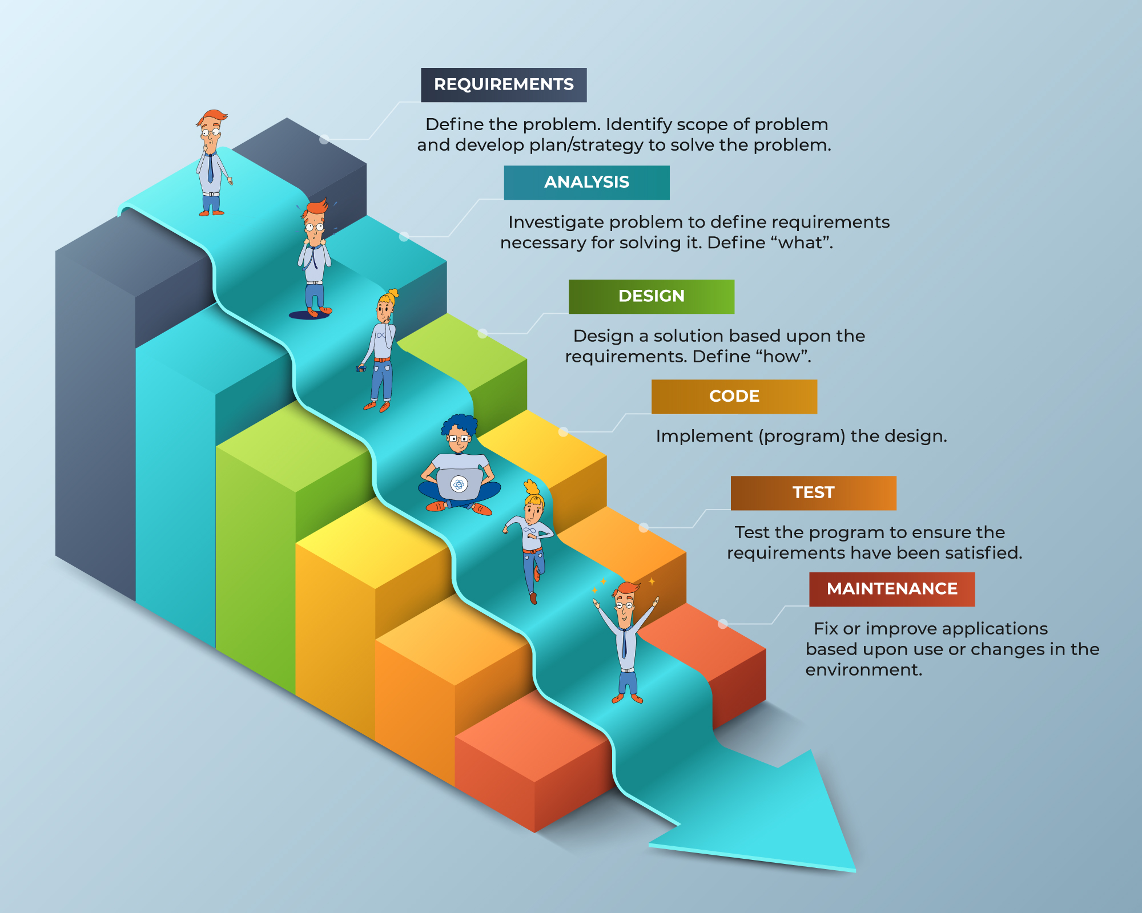
To my right is a waterfall methodology diagram. Now if I would have applied this to the SNHU Travel project it might have worked but, I would need to have all the requirements in the stories upfront because using the waterfall you can’t make any changes later.

Slide 5
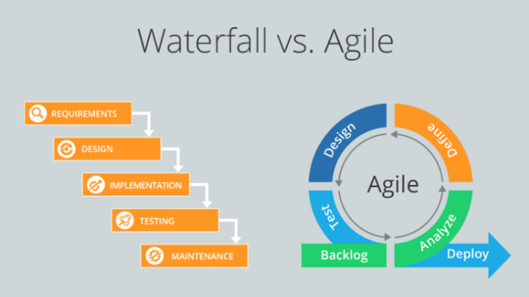
When looking at the diagram above and choosing what factors I would have used in my approach. The answer would be agile because you can implement smaller iterations. That comes in handy when you need to make changes to the customers requirements. When is waterfall used vs agile? If the project timeline is fixed and can not be moved, Waterfall will offer a more predictable outcome. If you need to get the project delivered in a short amount of time, Agile is the appropriate choice here where action and getting things built is more important than documentation and process (Parsons, 2019).

Slide 6
References
Samuel Nicholson. (2022). Agile Scrum Roles And Responsibilities.
Tim Parsons. (2019). When to Use Waterfall vs. Agile.
Anna Vorobiova. (2021). SOFTWARE DEVELOPMENT LIFE CYCLE: NIX APPROACH TO SDLC.

